Slide 1

Diversity Roundtables
Rollout

Slide 2
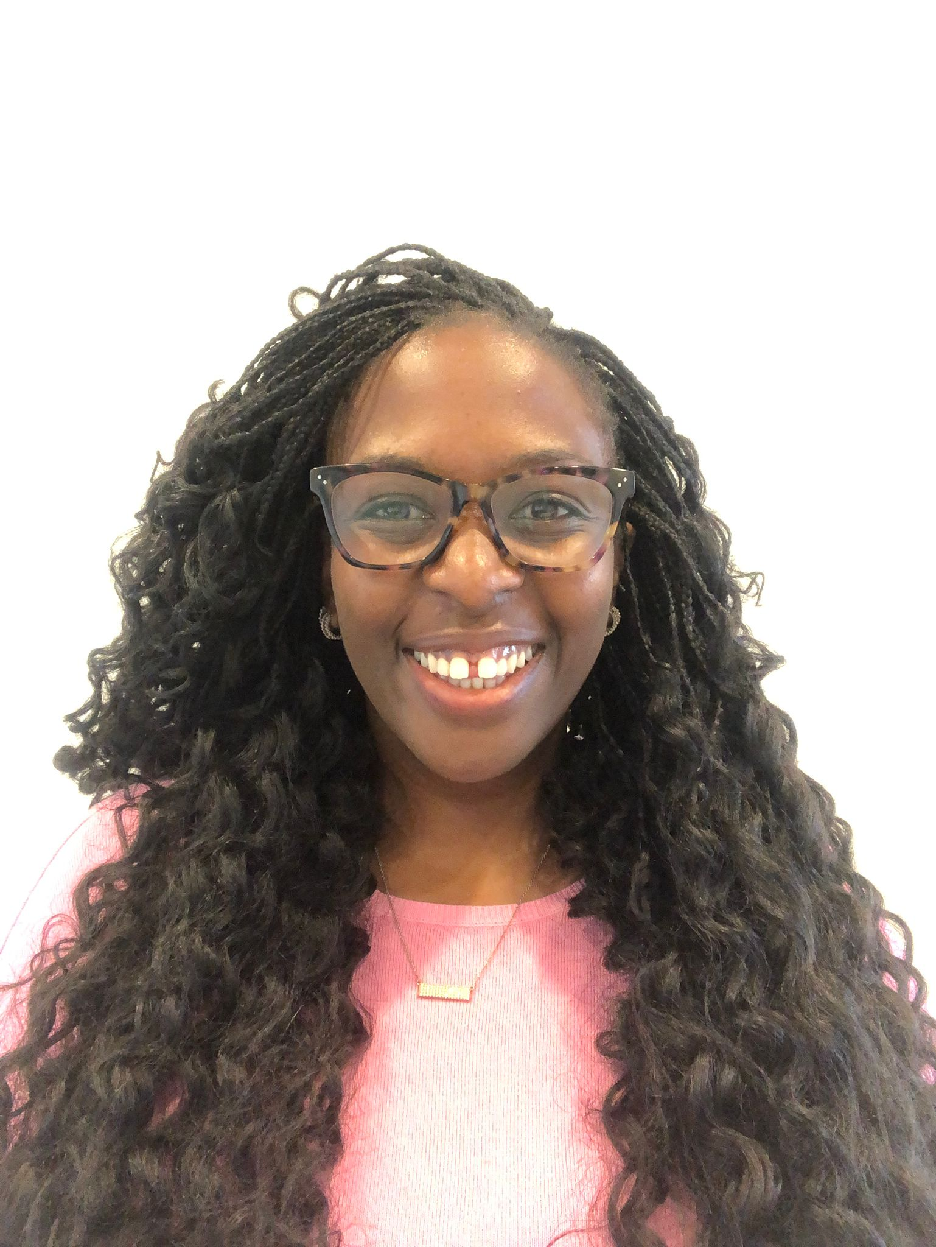

Foreword
I am committed to building a more inclusive workplace for all of us. Improving our Diversity & Inclusion (D&I) awareness, skills and behaviours is crucial to build a shared understanding to allow us to harness our collective power to drive inclusion at Howden.
For me inclusion starts with curiosity and conversation and that is why my pledge speaks to my commitment to facilitate that. My pledge is about creating opportunities that allows us to talk openly, honestly and freely and to learn from each of our experiences. That is why, I pledge to:
"Help build a culture that encourages us to be curious of others, which in turn will help us better understand how we can continue to build a more inclusive workplace by rolling out of Diversity Roundtables across the group"
Vusa Tebe
Group Diversity & Inclusion Manager

Slide 3
Overview of Diversity Roundtables
What
Diversity Roundtables provide employees with an opportunity to speak and listen to each other in an atmosphere of safety and equality
Why
Increases conversation around inclusion, promoting awareness and building knowledge of others experiences
Builds and fosters inclusive awareness, skills and behaviours
Cultivates empathy, helping employees gain a shared sense of understanding
How
Topics can be aligned with International or local D&I Awareness days, public holidays, ERGs or D&I activity
There will be open invitations to all who want to attend (capped at c30 to ensure we can maintain a safe space), relevant articles and that months Inclusion Edit will be sent as pre read
What is it not
Opportunities to shame / call out individuals for previous non inclusive behaviour
Forums for general business gripes
Training sessions; their primary aim is not education
Forums for debates or problem solving exercises.

Slide 4
Outcomes of Diversity Roundtables
Key D&I initiative
We are launching Diversity Roundtables as an initiative to support employees, managers and leaders in fostering an inclusive environment where every employee can grow, contribute and achieve
These events invite diversity of thought and experience to help build greater understanding
All are welcome, as we all play a role in building an inclusive culture
What do we aim to achieve?
Partner with ERGs
Opportunity to partner with ERGs to amplify planned events and delve deeper into the conversation already taking place in the business
Our people are custodians of our culture
Diversity Roundtables are centred around the experience of the individuals taking part, which further embeds our philosophy that everyone has a part to play in creating an inclusive environment, as custodians of our culture #AllofUs
Development of inclusive behaviour
Diversity Roundtables encourage us to become curious of each other as we are exposed to experiences that are different from our own. This can prompt participants to reflect on their own experiences, perspectives and behaviours.
Listening culture
Running Diversity Roundtables will create a listening culture, where people feel heard, respected and valued – this in turn builds a strong culture of trust, collaboration and respect
More inclusive environment
Through Diversity Roundtables, our people learn more about diversity and inclusion in a safe space, allowing them to feel more comfortable and confident in talking about D&I and sharing their experiences, and have more inclusive everyday conversations
Leadership Engagement
Opportunity for leaders to engage and connect with the wider business and role model inclusive behaviour
4

Slide 5
Diversity Roundtable
Benefits
Alignment to local D&I awareness days, business events or other topics relevant to the business can act as an amplifier to organic conversations that are already taking place
Being aligned to international D&I awareness days allows for collaboration across regions going forward and sharing of learnings
With open invitations we will attract people who are open to the discussion, resulting in a richer dialogue, creating momentum for the program
Allow us to sign post D&I initiatives and resources available at Howden
Considerations
In person vs hybrid – easier to maintain a safe space in person but we recognise having virtual sessions allows for greater accessibility
Topics being discussed could provoke emotional reactions, a member of the D&I team or local HR will be in all sessions to offer support for colleagues and help to manage any situations
Logistics – consider team anchor days when booking in person sessions also consider timing e.g lunchtime vs evening
5

Slide 6

Delivery Structure
Location and delivery
Diversity Roundtables can take place in person or virtually depending on feasibility and local preference. It is our recommendation that, where possible, they are hosted in person to ensure the space remains safe for all throughout the session
A suggested total of c20 (for in person) and c30 (for virtual) participants will have the opportunity to join each session to experience candid, intimate and psychologically safe conversations.
For virtual events you will need to set up virtual break out rooms and ensure you have enough facilitators or monitor each room
Session length and frequency
Each Diversity Roundtables is designed to be stand alone session which, can form part of a broader plan of activity to drive and enhance conversations and awareness of different diversity topics.
We recommend hosting a Diversity Roundtable to amplify global or local D&I awareness days, public holidays or D&I activity in the business.
Each session will be 90 minutes in length and will include facilitation from a Howden senior leader as well as a keynote from external speaker, followed by participant discussion.

Slide 7
90 minute Diversity Roundtable Agenda
Introduction from senior leader (10 minutes)
D&I will work with the senior leader from Howden to help them to devise an introduction that shares positioning around the topic from both a D&I and organisational lens. They will introduce the format and purpose of the session.
Keynote conversation (25 minutes)
The external speaker will then speak on the topic to bring it to life, illuminating how it affects specific groups with relevance to the employee population at Howden highlighting that inclusion is for everyone and providing participants with practical tips they can take forward
Facilitated discussions in smaller groups (25 minutes)
The external speaker will lay the foundations for a facilitated discussion to take place in small groups (c5 people). External speaker will close the group discussions by sharing tips and what we can do moving forward based on what they heard in the smaller discussions allowing for any questions to be asked.
Group sharing exercise (20 minutes)
The senior leader, D&I or local facilitator will lead the group through a sharing and learning activity around the topic, encouraging the group to speak openly about how this relates to their role and wider organisation as well as sharing (if comfortable) personal stories. The decision, on approach will be taken in the meeting with external speaker 3 weeks before the event.
Summary and signpost to available support (10 minutes)
The senior leader will then close the session with a summary of personal reflections / learnings from the workshop. Participants will be signposted to the support materials, departments and people that are available from Howden as they move forward.
This is a proposed agenda, we recognise the need for flexibility
based on topic and speakers

Slide 8




Choosing a Topic
International D&I Awareness days
You may choose to align your Diversity Roundtable to an international D&I Awareness day
For Example
World Mental Health Day
International Men’s Day
International Women’s Day
International Day of People with Disabilities
International Day to Combat Islamophobia
Pride month
Local D&I awareness days / public holidays
You may choose to align your Diversity Roundtable to local D&I Awareness days or local public holidays
For example:
Black History Month (UK & US)
January 26, aka Australia Day (Australia)
Day of the Dead (Mexico)
National Day (Singapore)
White cane week (Canada)
Fall of Berlin wall (Germany)
Business Events
You may choose to align your Diversity Roundtable to D&I Awareness day that are relevant to your region
For example:
Response to survey feedback
Share scheme opening (socioeconomic mobility)
End of year review (understanding bias)
Acquisitions (managing change)
Your choice
You can also choose your own topic that is of interest to people in your organisation

Slide 9

Finding Speakers
For each session we recommend having a speaker that is a SME with ample knowledge or lived experience relating to the subject at hand.
We advise to select a speaker not only for their knowledge but for their ability to provide content that will be relatable to our people whilst encouraging thought provoking discussions.
D&I Partnerships
D&I has access to a network of international speakers we can connect different regions and entities to
Individuals Network
Individuals may know of, or be connected to different speakers that they wish to invite to speak at a Diversity Roundtable
Local Speaker Academy
D&I can help you identify and vet local speaker academies in your region

Slide 10
How to choose a speaker
See them in action – a great way to determine if they are right for your event is to watch them speak in person or watch a recording of a talk they gave.
Speak to them – having a conversation over Teams or in person allows you to ask them key questions and to get a feel as to how they carry themselves and how well you might work together. It’s also an opportunity for you to provide context about the event and Howden. You want a speaker that is interested in what we are doing at Howden and is thinking about how they can adapt their talk to make it more relevant to us.
Check out their online profile – check out a speakers website, any recent articles and posts on social media. It is important that any speakers we invite align to our people first value and have not been involved in behaviour or discourse we would consider to be non inclusive.
Cost – Speaker fees vary by location and profile of speaker. Before approaching a speaker directly, we advise researching average speaker costs in your region to get a sense of where their fee sits in relation to others.

Slide 11
Diversity Roundtable Preparation
Introduction meeting with External speaker, and D&I to:
Meet the speaker
Brief them on the objective of the session
Provide context to allow them to tailor keynote to our audience
60 minute Introduction meeting with external speaker and D&I to:
Meet the speaker
Agree on format of the session
Agree prompt questions to be sent in invite
Agree prompt questions for group discussions
Agree logistics on the day
Invite from leader goes out to agreed population and identified individuals
Invite content to be co created with leader and D&I
Invite to capture dietary requirements
30 minute meeting with speaker and D&I to
Address outstanding questions
Share event brief
Share speaker notes for
leader will be provided with list of attendees and job titles
15 minute meeting with speaker and leader before session held in leaders calendar
D&I or those responsible for local delivery will be available throughout to provide support
30 minute debrief to capture learnings and takeaways
Email sent to participants from leader that D&I or local HR will draft.
leaders takeaways
links to relevant resources e.g articles , Howden benefits , Respect Groups, Inclusion Edit etc
Feedback form
4 weeks before
3 weeks before
2 weeks before
10 days before
On the day
1-3 days

Slide 12
Roles and Responsibilities
Task | Leader | D&I / Local HR
Agree topic | R / A
Source Speaker | A | R
Vet Speaker | A | R
Draft and send invite capturing any dietary requirements if you are providing refreshments |  | R / A
Brief Speaker on event |  | R / A
Prepare event brief incl directions for speaker / running order / room logistics |  | R / A
Liaise with client services to find a suitable room and refreshments |  | R / A
Share dietary requirements |  | R / A
Prepare intro and closing speaker notes for leaders | A | R
Book speaker and leader intro (30 mins) |  | R / A
Share list of attendees and job titles with leader |  | R / A
Test speakers slides and any videos they want to share |  | R / A
Take pictures
ENJOY ☺
Book time with leader to capture reflections (30 mins) | A | R
Send email to participants sharing reflections, asking for feedback and sharing resources | A | R
Post in Workplace #AllofUs group | A | R
Share feedback with Leader and D&I Team |  | R/A
Before Event
On the day
Everyone
The next day

Slide 13
Appendix

Slide 14
Running Order on the day
Time | Who | What
1 hour before | Howden HR | Check layout of the room
45 minutes before | Howden AV team and Howden HR | Support for laptop connection, clicker, screen and mics Speakers
45 minutes before | Catering team | Layout refreshments in room
30 minutes before | Attendees | Attendees arrive for refreshments and light lunch
30 minutes before | Speaker and leader | Intro meeting ahead of session
Event Start time

Slide 15
Connecting Back to the Business
Diversity Roundtables are a great way to signpost to participants different support, tools and events that are relevant both during and following the event, see the example below, which would be relevant for the UK:
D&I Awareness Day
Howden Resources to sign post to participants
Employee Assistance
Programme
Mental Health
First Aiders
International Women's Day
Diversity Roundtable
Reward Hub
HR Policies
External Events
Respect ERGs
Learning Portal
Wellbeing hub

Slide 16




Learn more about Karl
UK EXAMPLE
Karl Lokko
Click here
Black Seed
www.blackseed.ventures
Karl Lokko
Poet, activist, former gang leader and philanthropist
Karl has spent the past decade of his life advocating for a fairer and more inclusive business ecosystem. A gifted orator and poet, Karl is regularly invited to speak at corporate, public and charity events. He is the co-founder and chairman on Black Seed Europe’s largest Black fund for Black founders by Black founders.
X formerly Twitter
@KarlLokko

Slide 17
Howden Resources Available
UK EXAMPLE
HR Policies:
  Workday link here
HR Business Partner:
  If you are unsure of your HR Business Partner, you ask your manager or raise a case in Workday
Employee Assistance Programme:
  Call 0844 8922 493 (24 hours a day, 7 days a week); or
  Visit the Health Assured website here. Login details: Username: Wellbeing; Password: HowDenGroup94
Wellbeing Hub:
  Link here
  Better Up Coaching:
Workplace Link here
  Learning Portal:
  Workday Link here
Reward Hub:
  Link here
D&I:
  Email: diversityandinclusion@howdengrp.com
Respect ERGs:
  Workplace page here
  Email: Respect@howdengroup.com
Dive In:
  Website here

Slide 18
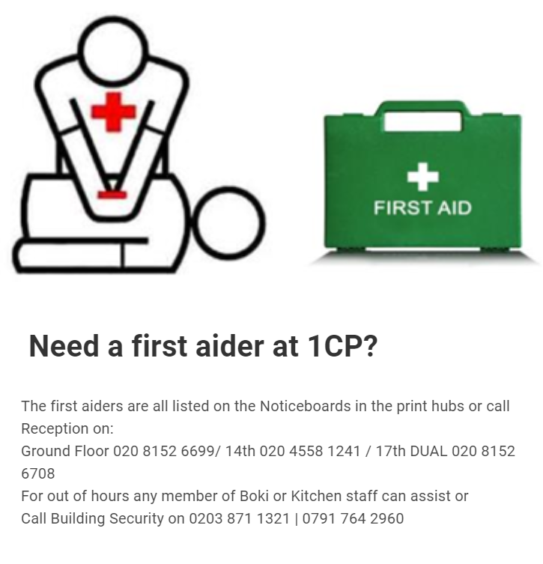
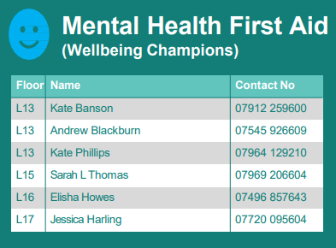

Mental Health First Aiders and First Aiders
UK EXAMPLE

